Slide 1

Skin Cancer Localization and Classification Name : Sriyans Roll Number : 1801cs52

Slide 2
Introduction
In this project we had to localize and classify skin cancer lesion as benign or malignant . We used a different approach to localize the lesion and used KERAS API for creating model to achieve so.

Slide 3
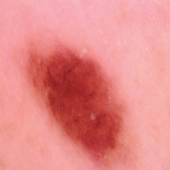
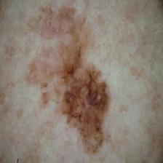
Visual difference between Non-cancerous and Cancerous lesion
Benign
Malignant

Slide 4
Steps
Preparation and Pre-processing of data.
Creating the CNN model.
Training the model.
Evaluating the model with test data.

Slide 5
Preparation and Pre-processing of data.
To separate the lesion we did the following steps.
Note : All the steps were performed on temporary image.
Blurred the image using median blur to reduce noise.
Threshold the image to get the contour.
Then performed contour detection.
From all contours found we took the closet one to the centre and with a decent size otherwise we took the whole image.

Slide 6
Preparation and Pre-processing of data.
5. After the appropriate contour was found we separated it out in a rectangle and then re-sized the image to a standard size(224x224).

Slide 7
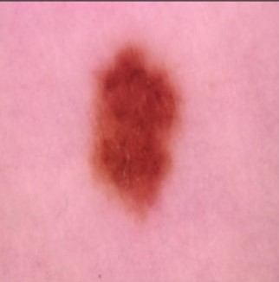
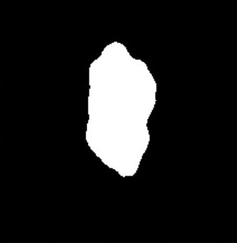
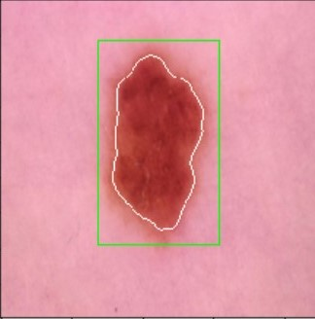
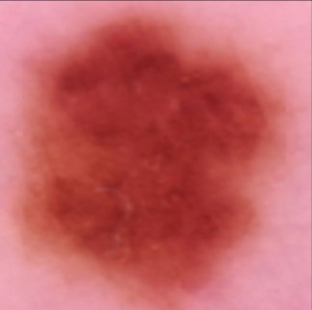
Pre-Processing Steps
Original Thresholded Contour Marked Final Image Image Image

Slide 8
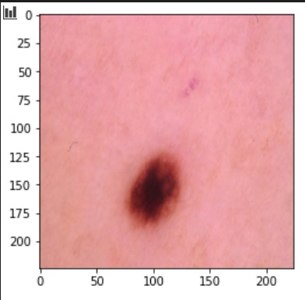
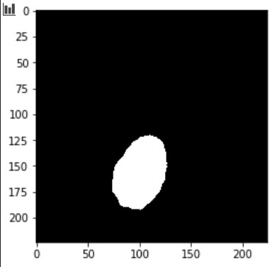
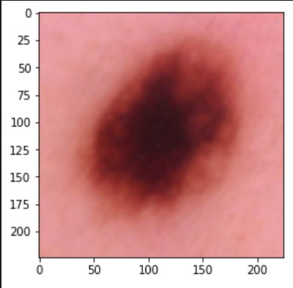
Different Cases
Ideal Case : Where there was a proper patch.

Slide 9
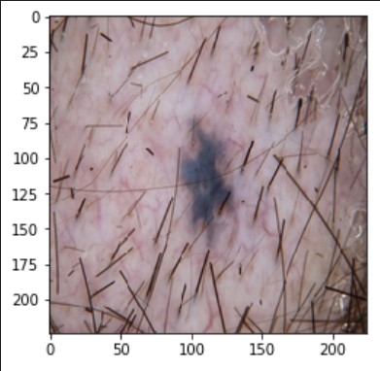
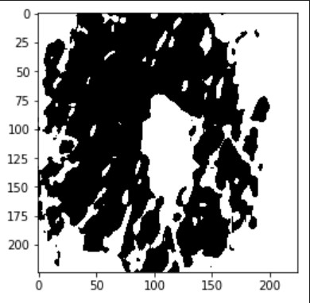
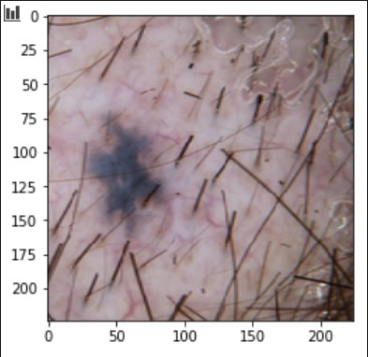
Different Cases
Case 2 : With hairs or any distortions.
The problem was roughly solved by tweaking a few parameters.

Slide 10
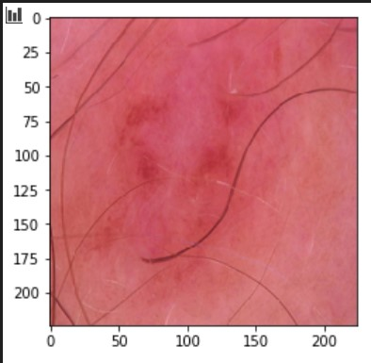
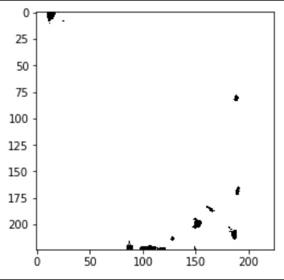
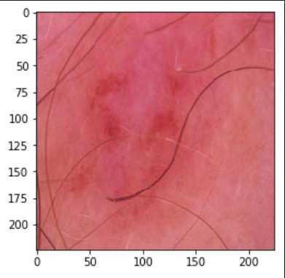
Different Cases
Case 3 : With no clear patch
In this case whole Image was taken.

Slide 11
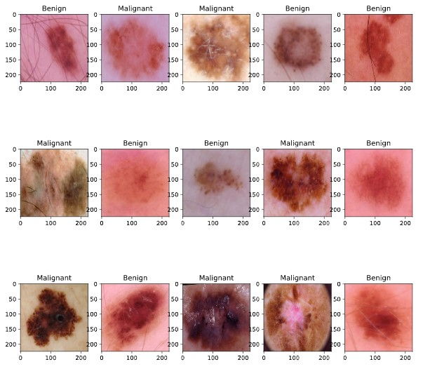
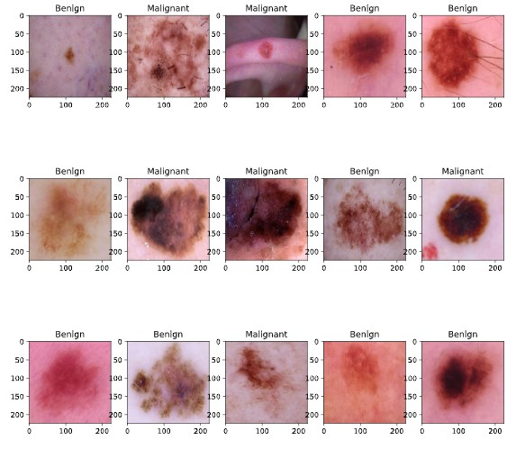
Random Images After Pre-Processing
Training data
Testing data

Slide 12
Constructing the Model
Here, we've used Keras “Sequential” to instantiate the model. It takes a group of sequential layers and stacks them together into a single model.
Into the Sequential constructor, we pass a list that contains the layers we want to use in our model.
A Sequential model is appropriate for a plain stack of layers where each layer has exactly one input tensor and one output tensor

Slide 13
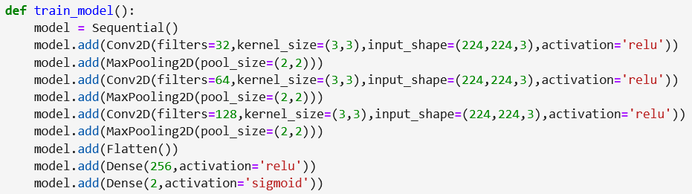
Constructing the Model
We have used Conv2D(Convolutional layer),MaxPooling2D ,
Flatten and Dense Layers.

Slide 14
Layers
Conv2D(Convolutional Layer)- The first required Conv2D parameter is the number of filters that the convolutional layer will learn.
In every layer filters are there to capture patterns. For example in the first layer filters capture patterns like edges, corners, dots etc. In the subsequent layers we combine those patterns to make bigger patterns. Like combine edges to make squares, circle etc.
Now as we move forward in the layers the patterns gets more complex, hence larger combinations of patterns to capture. That's why we increase filter size in the subsequent layers to capture as many combinations as possible.

Slide 15
Conv2D
Kernel - kernel size is always odd because for an odd-sized filter, all the previous layer pixels would be symmetrical around the output pixel. Without this symmetry, we will have to account for distortions across the layers.
The activation parameter to the Conv2D class is simply a convenience parameter, allowing you to supply a string specifying the name of the activation function you want to apply after performing the convolution.

Slide 16
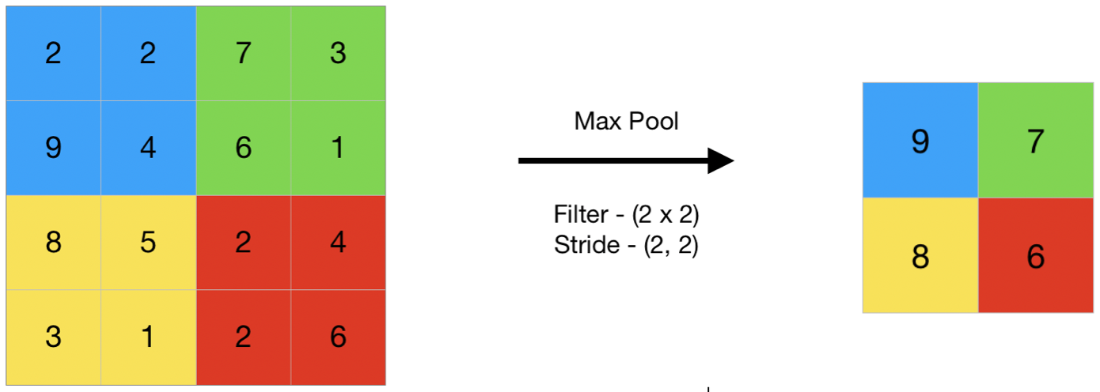
Maxpooling2D
Downsamples the input representation by taking the maximum value over the window defined by pool_size for each dimension along the features axis. The window is shifted by strides in each dimension.

Slide 17
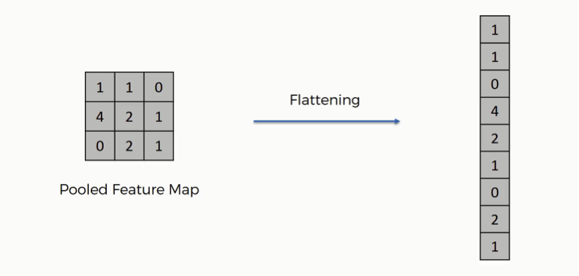
Flatten
Flattens the input. Does not affect the batch size.

Slide 18
Dense
Regular densely-connected NxN layer.
2nd dense layer is the final layers with only two neurons for each category (Benign and Malignant).
We have used “sigmoid” activation because our model has to predict probability and since probability of anything exists only between the range of 0 and 1, sigmoid is the right choice.

Slide 19
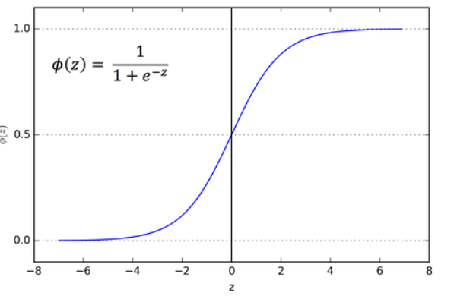
Dense
Sigmoid -

Slide 20
Training the model
Training data set has 1,440 images of Non-Cancerous lesion and 1,197 images of Cancerous lesion.
20 % of this data will be required for validating the model.
Model will be trained 20 epochs.

Slide 21

Compiling the Model
Binary Cross-Entropy Loss
It is a Sigmoid activation plus a Cross-Entropy loss.
Adam Optimizer
Adam can be looked at as a combination of RMSprop and Stochastic Gradient Descent with momentum. It uses the squared gradients to scale the learning rate like RMSprop and it takes advantage of momentum by using moving average of the gradient instead of gradient itself like SGD with momentum.

Slide 22
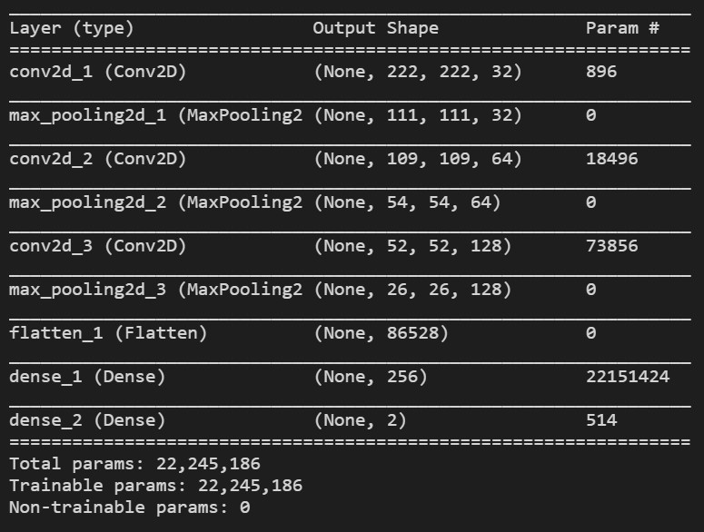
Model Summary

Slide 23
Results
Training accuracy = 93.36% , loss value = 0.17
Validation accuracy = 84.38% , loss value = 0.52
Test accuracy = 83.00% , loss value = 0.45

Slide 24
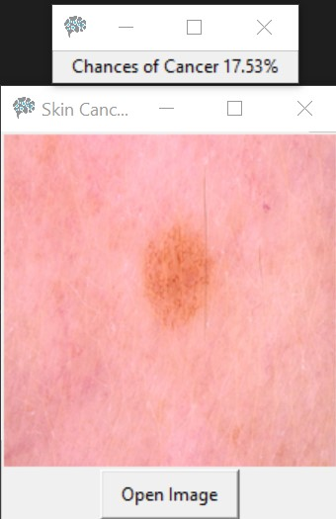
Output and UI

